Slide 1



D e s i g n P a t t e r n s
Design Patterns Research
COMPRESS (UN)
Under the Esteemed Guidance of
Prof Dinesha. K. V.
By :
  Shahid Kamal 2005 115
  Venkata Thippanna Rao. P. R. 2005 145
H e a d F i r s t D e s i g n P a t t e r n s a n d o t h e r w e b r e s o u r c e s
S o u r c e

Slide 2
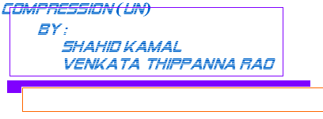
C O N T E N T S
Introduction
1.1) Overview and Usage of System
1.2) Existing Systems
1.3) Focusing for a Better Solution
Architecture of the System
Objects of the System
Functionalities of the System
4.1) Online Utility Provider
4.2) Stand alone Provider
4.3) Context Based Usage
4.4) Command Interpreter mode
Implementation Document
Patterns that can be employed
5.1) Architecture Level
5.2) Component Level
5.2.1) Model Level
5.2.2) Controller Level
5.2.3) View Level
5.2.3.1) Web based View
5.2.3.2) Stand Alone View
Conclusion
Design patterns
Research

Slide 3
1.1 Overview and Usage of System
1.2 Existing Systems
  WinZip utility for windows
  WinRar for Windows
  Tar for Linux
  GZip for Linuz
Design patterns
Research
q
1.3 Objectives
To provide the flexibility to offer this service through any channel (either internet/stand alone/etc.
To make use of Design Patterns effectively in order to make the software robust enough for CHANGE.
To Provide a robust way to reflect the change to the existing installed base (this is in case of Stand alone Application).
1.4 Focusing for a Better Solution
The design that we emphasized on here does points a solution to this problem of reflecting the new change without reinstallation.
The design also focuses on the provision of this feature made available through different channels (either internet/stand alone/etc.

Slide 4
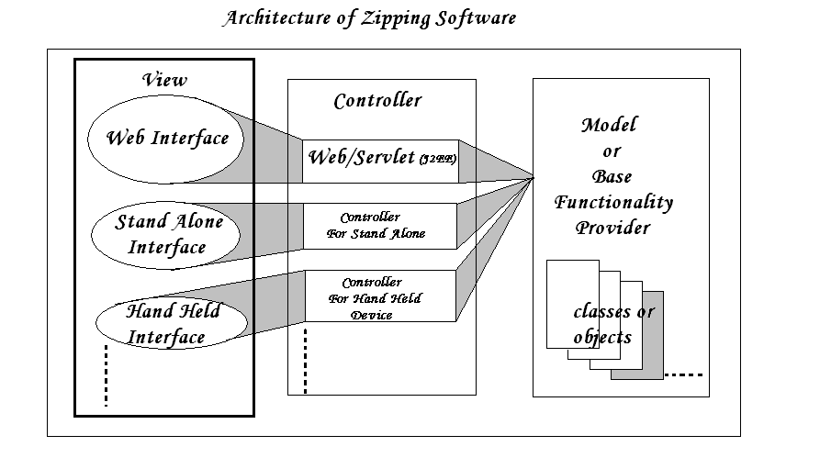
ARCHITECTURE
S o u r c e

Slide 5
P r o x y P a t t e r n
OBJECTS
The Objects on which the system works on are two abstractions of storage of information basically.
The Two Abstractions i.e.., Objects
Files
Folders
Therefore the Objects of the system are :
  Files Object
  Folder Object
  Object handling the Algorithm for Compression and decompression are :
  Compressed File (All the formats are to be Supported)
  Object handling Security issues
H e a d Fi r s t D e s i g n P a t t e r n s a n d o t h e r w e b r e s o u r c e s
S o u r c e

Slide 6
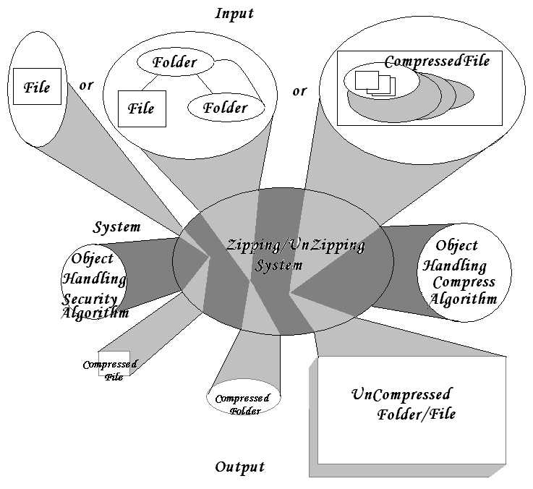
P r o x y P a t t e r n
DIaGRAMATIC REPRESENTATION OF OBJECTS INVOLVED
H e a d Fi r s t D e s i g n P a t t e r n s a n d o t h e r w e b r e s o u r c e s
S o u r c e

Slide 7
P r o x y P a t t e r n
FUNCTIONALITIES OF THE SYSTEM
Online Utility Provider
In case of serving the purpose of Compression and decompression online, the functionalities are limited to just :
  Compress the File/Folder
  Uncompress File/Folder
Stand alone Provider
In case of a stand alone application installed on the system, the functionalities to be provided are :
  Compress the File/Folder
  Uncompress File/Folder
  Add files to the Archive
Context Based usage
Command Interpreter Mode: The application should provide a command like
“compress filename/foldername destinationpath”
And
“uncompress filename/foldername destinationpath”
H e a d Fi r s t D e s i g n P a t t e r n s a n d o t h e r w e b r e s o u r c e s
S o u r c e

Slide 8
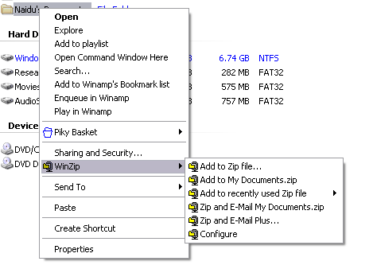
P r o x y P a t t e r n
CLASSIC EXAMPLE OF “WinZip” CONTEXT SENSITIVE MENU
H e a d Fi r s t D e s i g n P a t t e r n s a n d o t h e r w e b r e s o u r c e s
S o u r c e

Slide 9
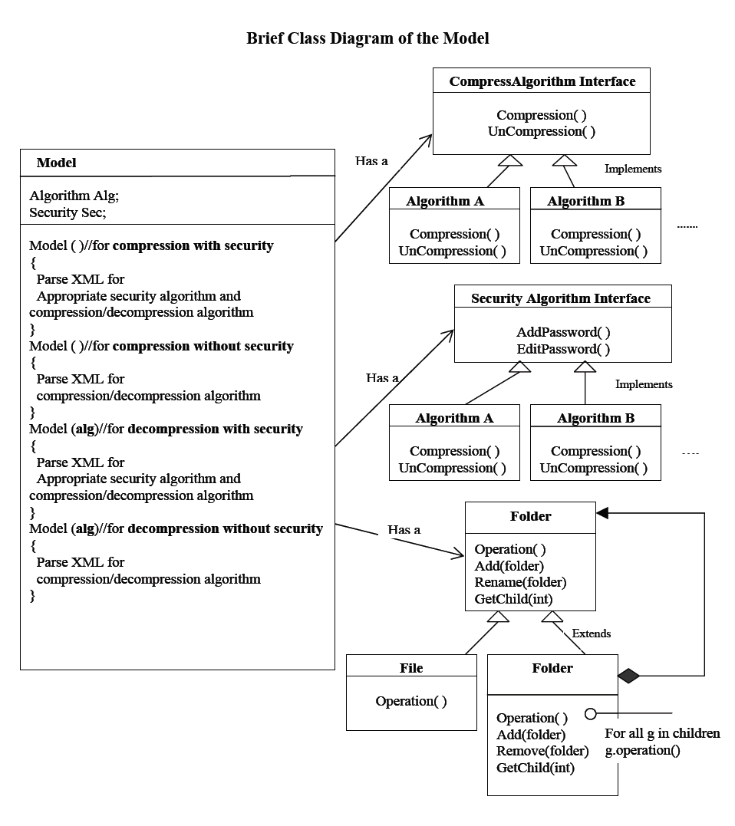
CLASS DIAGRAM

Slide 10
P r o x y P a t t e r n
IMPLEMENTATION DOCUMENT
Patterns that can be employed
Architecture Level:
The MVC architecture can be employed to better decouple the Implementation .
Component Level
  1. Model Level
    Observer Pattern
    Strategy Pattern
    Composite Pattern
    XML Integration Pattern
2. Controller Level
    Strategy Pattern
3. View Level
    Web based View
    Composite pattern
H e a d Fi r s t D e s i g n P a t t e r n s a n d o t h e r w e b r e s o u r c e s
S o u r c e

Slide 11
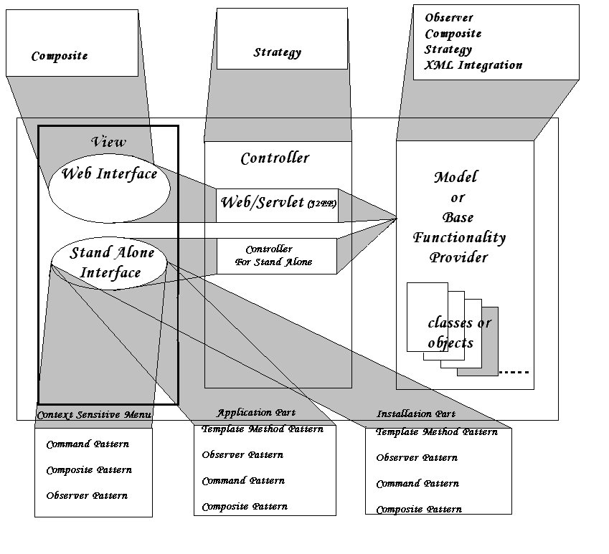
P r o x y P a t t e r n
Patterns Based View

Slide 12
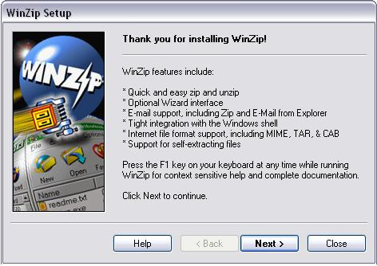
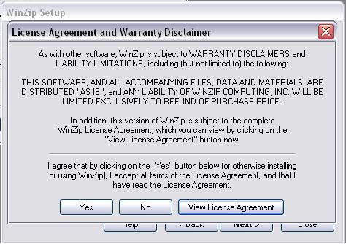
P r o x y P a t t e r n
STAND ALONE VIEW
3b.1. Installation Part:
Template Method Pattern
H e a d Fi r s t D e s i g n P a t t e r n s a n d o t h e r w e b r e s o u r c e s
S o u r c e

Slide 13
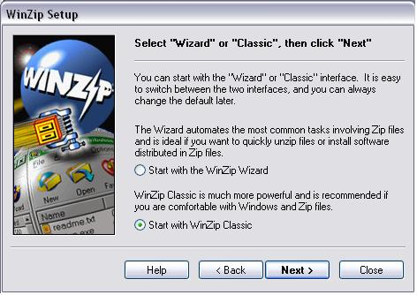
P r o x y P a t t e r n
STAND ALONE VIEW
3b.1. Installation Part:
Template Method Pattern
Step3:
H e a d Fi r s t D e s i g n P a t t e r n s a n d o t h e r w e b r e s o u r c e s
S o u r c e

Slide 14
P r o x y P a t t e r n
Observer Pattern
Command Pattern
Composite Pattern
3b.2. Application Part:
Observer Pattern
Command Pattern
Composite Pattern
3b.3. Context Sensitive Menu Part:
Command Pattern
Composite Pattern
Observer Pattern
H e a d Fi r s t D e s i g n P a t t e r n s a n d o t h e r w e b r e s o u r c e s
S o u r c e

Slide 15
P r o x y P a t t e r n
Conclusion
Thus the COMPRESS (UN) deals with the design issues concerned with the development of a Compression tool taking the features of the current utilities into account and the scope for improvement. For the development of robust software that always welcomes CHANGE.
H e a d Fi r s t D e s i g n P a t t e r n s a n d o t h e r w e b r e s o u r c e s
S o u r c e

Slide 16
P r o x y P a t t e r n
Thank You
H e a d Fi r s t D e s i g n P a t t e r n s a n d o t h e r w e b r e s o u r c e s
S o u r c e

